Slide 1

Vet Center Survey
Feedback from MVP, District 1 and 5
Michelle Middaugh, Senior Product Manager
January 2022

Slide 2
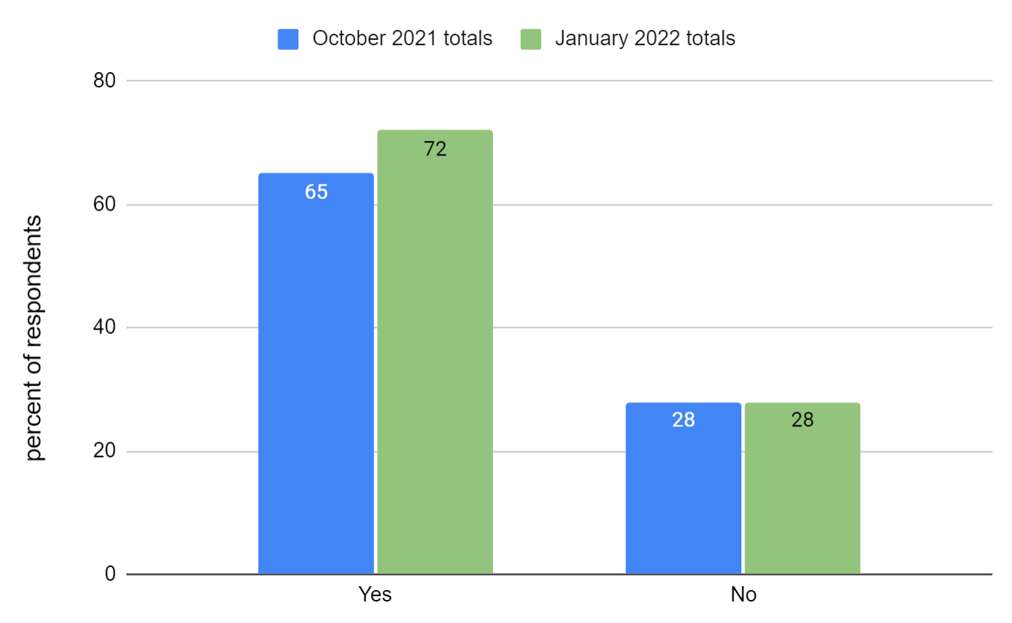
Have your pages been published?
Vet Center Survey, January 2022
 | Number of respondents
October 2021 | 49 from District 5
January 2022 | 29 from District 1

Slide 3
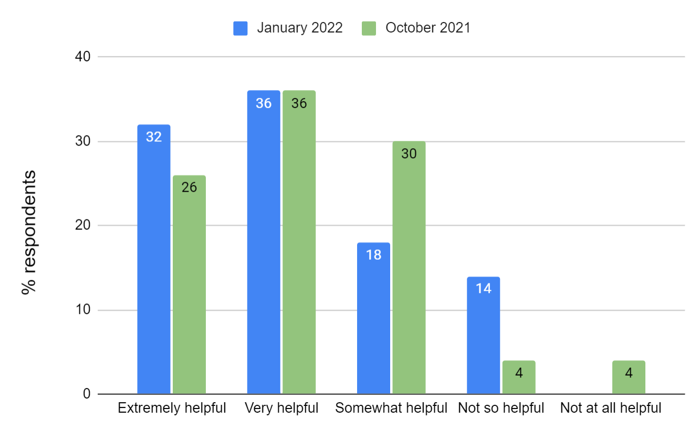
How helpful was the content workbook?
Vet Center Survey, January 2022
Nearly 70% of respondents found the content workbook very or extremely helpful.

Slide 4
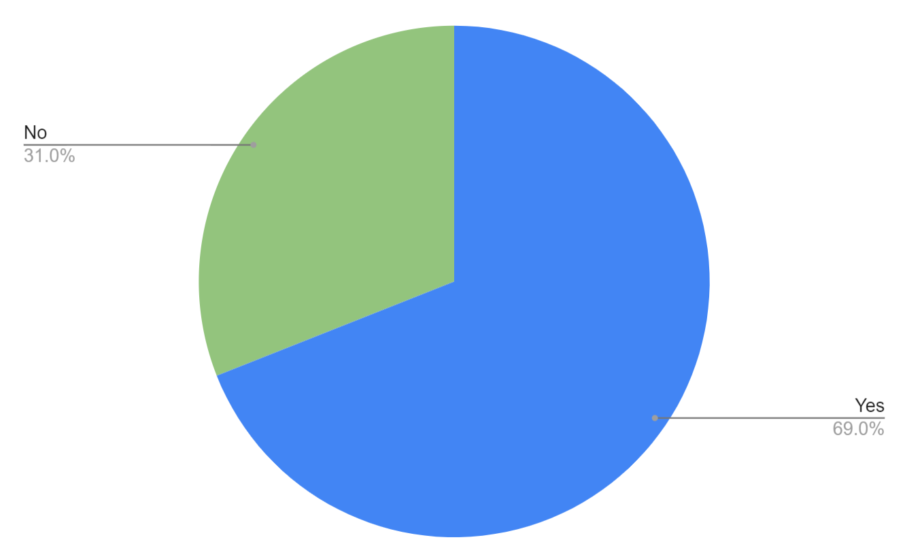
Did you receive 1:1 help from the project team?
Vet Center Survey, January 2022
(20 respondents)

Slide 5
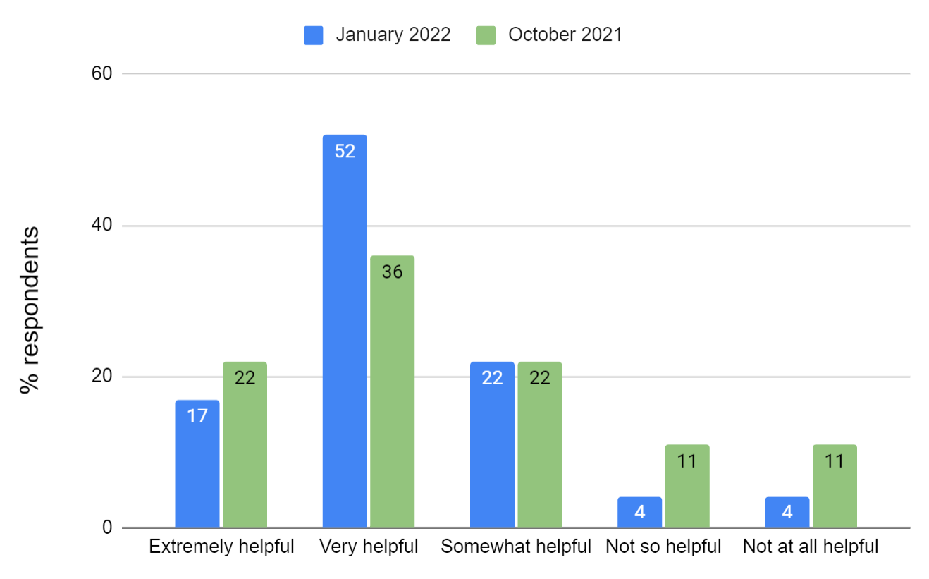
How helpful were the optional office hours?
Vet Center Survey, January 2022
Over 90% of respondents found office hours to be at least somewhat helpful with the vast majority of respondents rating them very or extremely helpful.

Slide 6
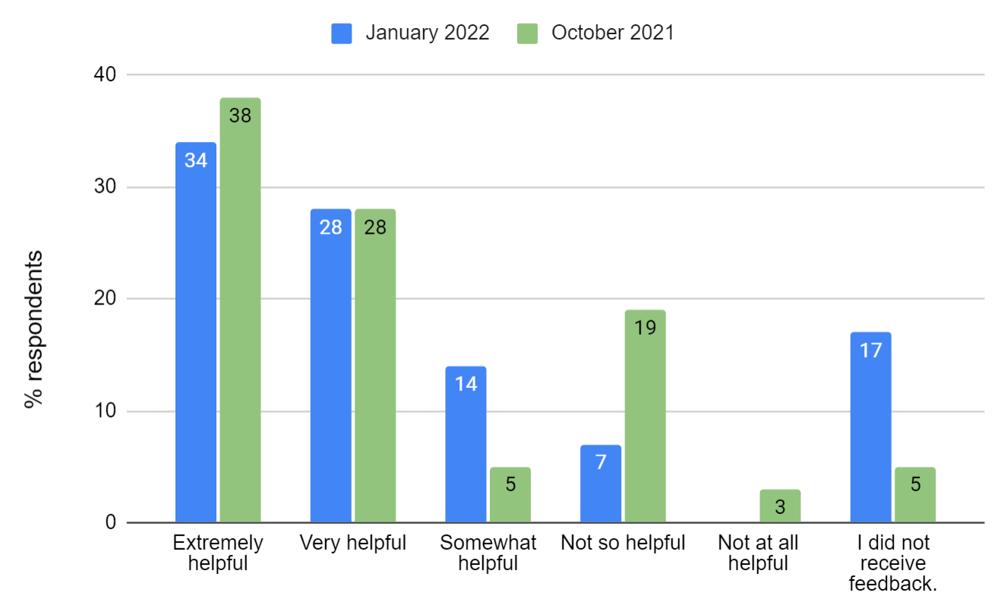
How helpful was the emailed feedback?
Vet Center Survey, January 2022
Respondents tend to find the emailed feedback at least somewhat helpful, with most rating it very or extremely helpful.
In the most recent survey, 17% indicated they did not receive feedback which may reflect the status of the project or the shift toward suggesting a time to discuss feedback, rather than sending it in written form.

Slide 7
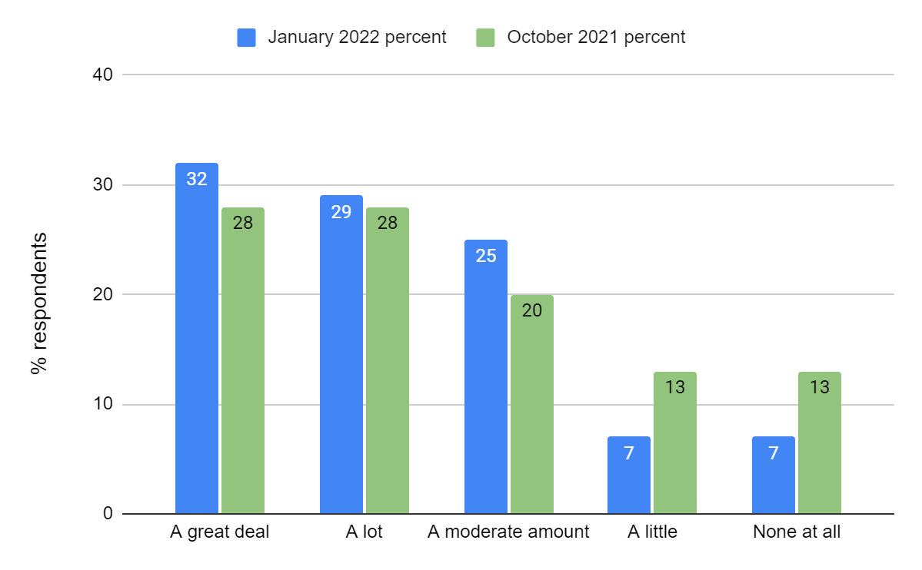
How much confidence do you have in your ability to maintain your website?
Vet Center Survey, January 2022
District 1 indicates a greater level of confidence compared to their District 5 counterparts.

Slide 8
What would have made this learning process easier? (Part 1)
Vet Center Survey, January 2022
Time
Time to attend to this or delegate to someone else.
A little longer turn around. Need at least a few months.
more time to complete. the deadline to complete was tight
Tech skills
having someone with an IT background handle this project
Building the website and continually editing it. Adding photos and graphics.
Some VOPS do not have the technical skills to do this project
I am not tech savvy, so getting started and being intimidated was the hardest part for me.
The Staff did great, just have to expand my knowledge of computers
If I had a better understanding of how to build a web page
Communication/expectations
If the project with timeline had been clearly communicated to the VCDs
Lack of communication from the district of the expectation
Clearer expectations
Features
Additional features, like being able to add staff bios and pictures and having more "spotlight" options would be great.

Slide 9
What would have made this learning process easier? (Part 2)
Vet Center Survey, January 2022
Finding the words
I struggle with not being able to change certain text describing services. But I understand the reasoning.
I was struggle little bit with the featured content
coming up with what to say in each area. But examples from the workbook were very helpful.
getting information from community partners that is accurate
Some training on writing/publishing for the government.
Gratitude
Very happy and appreciative this was done.
I can't think of anything. Honestly, the one-on-one was fantastic.
it’s not hard for me
This was rolled out very successfully
People from communications team were very helpful with my questions.
Over all, it was professional
Not a lot, the system was very simple and direct points of contact and times were given to provide assistance. There are some capabilities that I would like the page to have moving forward, but, for a MVP it was easy.
It has made it easier to access the Vet Centers through the digital experience.
The Team did an amazing job. They offered sessions at different times and days and I was able to get on several of them. it was helpful to hear what others were doing but I am a hands on learner so to see others pages was perfect.
Nothing for me, everything was provided and I didn't have to hunt anything down.

Slide 10
What would have made this learning process easier? (Part 3)
Vet Center Survey, January 2022
Drupal/Training/Resources
if you had developed a template that was easy to use. Basically , learning to "build" a website was not easy. and the terminology was unclear and hard to use. Like "accordion" was hard to learn. I don’t understand why this could not have been a "cut and paste" adding our individual information to an already built website and only adding the services we actually offer at our location.
Some terms were confusing, i.e., Spotlight and featured content. However, as I am coming very late on this project, maybe these items were made clear at the beginning.
The content workbook could have been written with more clarity. More disambiguation between the CMS learning and productive environments would have been helpful.
weekly training
Website construction tool could be vastly improved. It is not at all intuitive.
It seemed very abstract, until I looked at a live site and could see the direction and the purpose
Navigating the content workbook.
Website construction tool
Early on - navigation between public facing page and background.
creating the content actual as per directed
a group to actually go through a sample step by step one time would have helped.
A longer session each time
If we were properly training ahead of time and given a better heads up.
one on one from start

Slide 11
What would have made this learning process easier? (Part 4)
Vet Center Survey, January 2022
Other
typos in the templated material (for example, "whole health")
all aspects
Pictures of the VC and access points
It was too big of a burden on the Vet Centers
If I had been on this project from the start
You had to get it done despite heavy pressure of trying to maintain your own responsibilities
Great job educating....it is just one more new thing to learn and manage and there is a limit to what we are able to manage and focus on.
i found that this process was honestly a "pain in the butt". since it is basically making "our" page just like everyone else's page, it seems it would have been easier to either a) NOT have one at all or b) pre-publish ALL the data the same as all other locations, except for the picture/location info.
vision planning, brainstorming w/specific VC branding in mind w/highers, more flexibility
personalizing the website

Slide 12
What would have made this learning process easier? (Part 5)
Vet Center Survey, January 2022
“It would have made more sense for the consultants to develop a template website that was easy to drop our information into. The "practice pages" were a frustrating waste of resources. It should have been set up to be an easy and helpful way to get our information out to more people about Vet Centers. Instead it was like a college course while trying to get through our challenging work days at the same time. If I had a choice I would not go through that again. Surely your company could have built a user friendly , one-stop site so we could personalize our site. And another big problem is you don't seem to "get" the clients' needs. Not all Vet Centers have all the same things to offer- and to have things we don't offer presented as "things we offer" is confusing to clientele. Our veterans often spend hours on the phone trying to find some specific help. You were entering services into the mandatory accordions about all Vet Centers that we don't all offer. Think about this! Why would a veteran who has been trying to get up the nerve to call us about drug and alcohol addiction group sessions call up only to find they will be passed off to yet another "number to call" because we DON'T have that here. These folks spend a lot of time on the phone trying to find help, and giving them another number to call is just more fences for this very vulnerable group of people to jump through.”

Slide 13
What did you struggle with most?
Vet Center Survey, January 2022
Technical expertise or Drupal interface
Getting past all the glitches. There were things in the manual that did not work the way it said they would.
Initial clarification on Webpage input process sequence.
entering data sometimes had quirks about how it needed to be entered to be saved. This was challenging and wasted a good deal of time to figure out.
The site kicking me off.
Work being saved
Very limited # of characters allowed for event description
Limiting wordage, posting pictures, initially navigating certain sections
saving and publishing the services
Finding the words
transportation section
Giving the editors exactly what they wanted.
the continued back and forth with nitpicky suggestions that really didn’t impact the site one way or another
wording
Labeling some of the websites
how to use words that are acceptable to VA
Other
Nothing appeared streamlined, static, one size fits all. Does not tailor towards unique branding
Having time to complete it during my role transition from PSA to VOPS.
Allocating time for this.
I'm just a face to face public speaker
wasn't a struggle, it was taking the time to learn a new thing

Slide 14
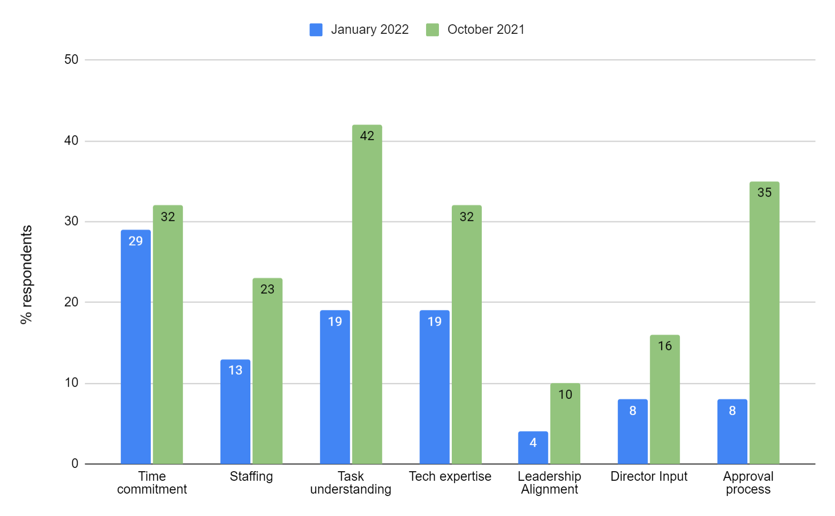
Which of these were barriers to your success, if any?
Vet Center Survey, January 2022
Time continues to be called out as a challenge but District 1 generally expressed fewer barriers than District 5.

Slide 15
What else would you like to share about this experience? (Part 1)
Vet Center Survey, January 2022
I believe it is going to be very difficult to maintain these pages on a continuous long term basis at the VOPS level
I feel they expected more from other vet centers, what other Vet Centers do is not mandatory for others to follow. I look at my page and see I have more input than others.
There is nothing wrong with the website execution or layout. It provides a spot to promote specific Vet Center information. However, I think RCS is missing a massive cost free opportunity by not participating in social media where the majority of people get their news and event information from.
I would love to be able to manage a calendar on the web page and publish photos and bios on our counselors. However, the overall process was simple and smooth and I am excited to have access to webpage for our clients!
It was a disaster and could have easily been cleaned up and simplified.

Slide 16
What else would you like to share about this experience? (Part 2)
Vet Center Survey, January 2022
Overall I think it went well and launched successfully
It seems well put together. I am excited about it
It is going to be great!
I would love to be able to manage a calendar on the web page and publish photos and bios on our counselors. However, the overall process was simple and smooth and I am excited to have access to webpage for our clients!
look forward to further training. It was refreshing to learn and apply something new...
thank you for the organization and effort!
Good experience, I wish when updates are made nationally we would get an update.
I would build web page again. Michelle and her entire team were fantastic. I hope that we can keep them around for future roll outs.
So very grateful to the Team for their guidance to get us here. Thank you!!!😊
It was exciting learning something new and figuring out how to use it as a tool

